Slide 1


Evaluating Open-Weight AI Models
A Comparative Study
Hacktoberfest 2026 Hack Day
SSIT, Tumakuru
Comparing correctness, instruction following, clarity and honesty across leading models.
Team: Syed Arfaz • Prajwal B • Pavan BS

Slide 2



Problem Statement
&
Objective
ACCURATE RELIABLE VERIFIABLE
Same prompt, different answers.
Open-weight models can respond in diverse ways.
Fluent doesn’t mean correct.
Well-written responses may still be inaccurate.
Our objective: fair and consistent evaluation.
Compare four open-weight models using the same prompts and a clear rubric.

Slide 3
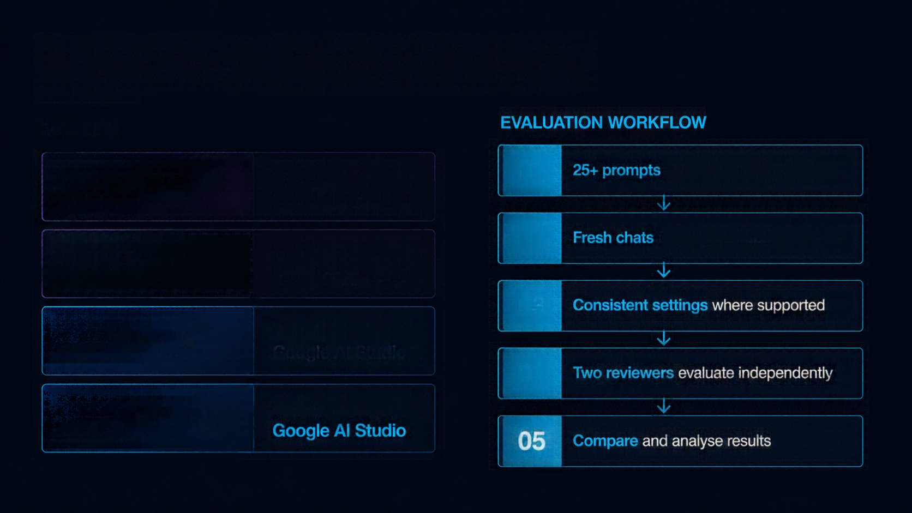

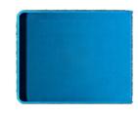




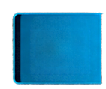
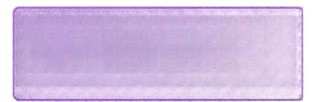





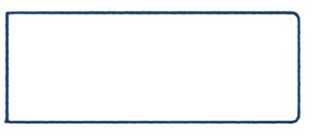


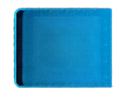





Models & Methodology
MODELS
EVALUATION WORKFLOW
Platform
01
25+ prompts across five categories
GPT-OSS-20B
Groq Playground
02
Fresh chats for every prompt
Platform
GPT-OSS-120B
Groq Playground
03
Consistent settings where supported
Platform
Gemma-4-31B-IT
Google AI Studio
04
Two reviewers evaluate independently
Platform
Gemma-4-26B-A4B-IT
Google AI Studio
05
Compare and analyse results

Slide 4

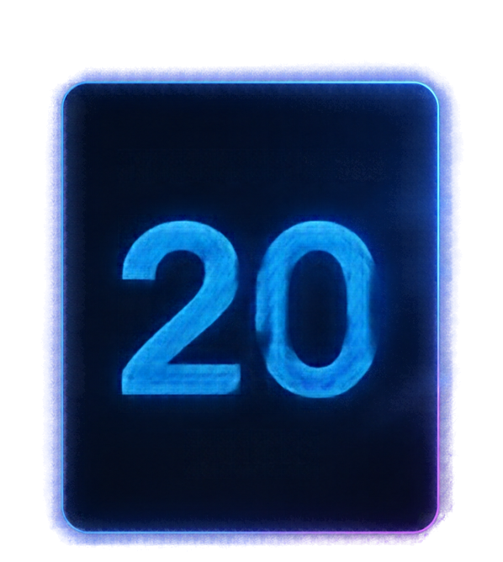






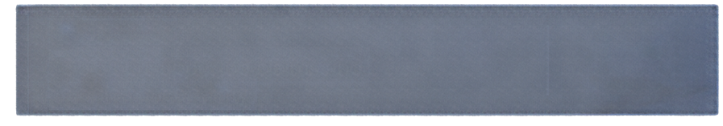

Scoring Rubric
Correctness
1-5
Maximum Total
accuracy
points
20
Instruction Following
1-5
obeys the prompt
points
Clarity
1-5
easy to understand and organised
points
points
Honesty
1-5
avoids unsupported claims and handles uncertainty
points

Slide 5







Results & Model Comparison
Team-reported total scores
out of 20
20
19
20
20
/20
/20
/20
/20
GPT-OSS-20B
GPT-OSS-120B
Gemma-4-31B-IT
Gemma-4-26B-A4B-IT
Source: scores reported by the team.

Slide 6

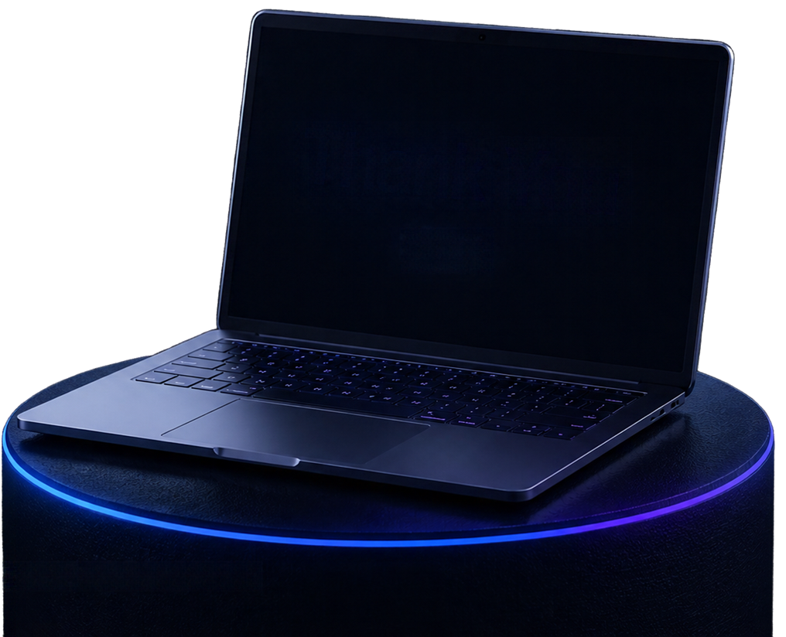

Conclusion,
Team & GitHub
Thank
You
Three models scored 20/20;
one scored 19/20 in our evaluation.
Q&A
Results depend on prompt selection
and reviewer judgments.
Team:
Syed Arfaz, Prajwal B, Pavan BS
View Our Project on GitHub:
https://github.com/prajwalprajju1017-jpg/open-model-evaluation/tree/main

